Slide 1

Amrutvahini College of Engineering, Sangamner
Department of Electronics & Telecommunication
Presentation On
Android Controlled Robot Car
Under The Guidance of
Miss.R.N.Deokar
(Assistant Professor AVCOE, Sangamner)
By
Mr. Pranav Ambre (Roll No:04 ) Mr. Shubham Bhadake(Roll No:08) Mr. Abhishek Gade (Roll No:16) Miss.Smita Mandlik(Roll No:42)
Dr. S. R. Jondhale
(Project Coordinator)
Dr. R. P. Labade
(H.O.D, E&TC)

Slide 2
Outline
•
Introduction of the topic Need of Project
Project Aim and Objective Related Work
System Block Diagram Methodology (Algorithm/Flowchart)
Working
Applications of the Project
Discussion on Results
Conclusion
Budget of the project
REferences
•
•
•
•
•
•

Slide 3
Introduction of the Project:
•
A robot is a mechanical or virtual artificial agent, usually an electromechanical machine that is guided by a computer program or electronic circuitry.
The first digital and programmable Robot was invented by George Devol in 1954 and was named the Unimate. Apps control robot is one where the controlling is done by the smartphone apps using Bluetooth.
It is possible to control of different parameters of many applications such as to control the speed, light, direction, sound and temperature. Nowadays smart phones are becoming more powerful with
•
•
reinforced processors, larger storage capacities, richer entertainment function and more communication methods.
•
Recently the Bluetooth technology has become the standard for device- to-device
communications for short distance.Bluetooth is an open standard specification for a radio
frequency (RF)based, short-range connectivity technology that promises to change the face of computing and wireless communication. I
Now a day’s robotic cars are developed by using Wireless technology. Wireless technology in Robotics starts with Bluetooth, WI-FI, and Zigbee Communication. Based on the Requirement and Application they deployed the communication in Projects.
•

Slide 4

Need of Project
•
We know that, Electric vehicles use electricity to charge their batteries instead of using fossil fuels like petrol or diesel. Electric vehicles are more efficient, and that combined with the electricity cost means that charging an electric vehicle is cheaper than filling petrol or diesel for your travel requirements.
In this project we controlling Electric car using wirelessly through Android smart phone using the Bluetooth module through UART protocol with the Robotic mechanism.So, user can control the Electric car from anywhere within the rang of controlled.
•

Slide 5
Project Aim and Objective
•
Aim: The aim of this project to designing a ROBOTI car that can be operated wirelessly through Bluetooth communication using Android Apps on smart phone. To avoid the vehicle/car accident by using the different-different sensor models.
Objective:
1.To control the car with help of Android phone. 2.Drive the car/vehicle safely and with the security. 3.Avoid the Accidental cases.
4.Maintain the Environmental balance(with ECO-friendly).
•

Slide 6
Related Work
In, the author shows that their robot is to design the Android control robot car. There are some hardware components are used like microcontroller Arduino UNO Ultrasonic distance sensor, Bluetooth Module, DC gear motor, Motor driver, Boost Converter, Temperature sensor, etc.
In this system main purpose will to control the speed ,direction of car and detecting the obstacles in front of the car to avoid the accident. For the tackle this situation of accident author work on this robot car.
In this, project the author divided the project in main three units such as follows: • Sensing Unit:-In this ,unit the car sense the data related the obstacle in front of him, speed of car through the different- different sensors. • Processing Unit:-It is responsible for the processed on the input which received from the sensing unit. • Controlling unit:-It is responsible for the controlling the car on the basis of the received data

Slide 7

System Block Diagram
Following block diagram show the actual working of the Android controlled Robot car. As shown in fig. We can control the robot car by the help of Android phone. As the connection shows in fig. The Android phone is connected to the microcontroller by the help of Wireless modul to send the instruction to the microcontroller to control the speed and direction of car. And the microcontroller is connected to the Motor Driver IC and then Motor Driver IC is connected to the Motor

Slide 8




DC
Motor
Battery
Microco- ntroller (Arduino/ ESP8266)
MotorDriver IC
Android Webpage / App
Wi-Fi Module
DC
Motor
Fig.A

Slide 9
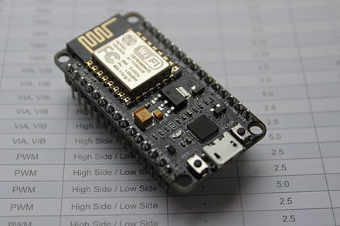
NodeMCU
NodeMCU (Node MicroController Unit) is an open-source software and hardware development environment built around an inexpensive System-on-a-Chip (SoC) called the ESP8266.
The ESP8266, designed and manufactured by Espressif Systems, contains the crucial elements of a computer: CPU, RAM, networking (WiFi), and even a modern operating system and SDK. That makes it an excellent choice for Internet of Things (IoT) projects of all kinds.
However, as a chip, the ESP8266 is also hard to access and use.
You must solder wires, with the appropriate analog voltage, to its pins for the simplest tasks such as powering it on or sending a keystroke to the “computer” on the chip. You also have to program it in low-level machine instructions that can be interpreted by the chip hardware.
The Node MCU is available in various package styles. Common to all the designs is the base ESP8266 core.

Slide 10
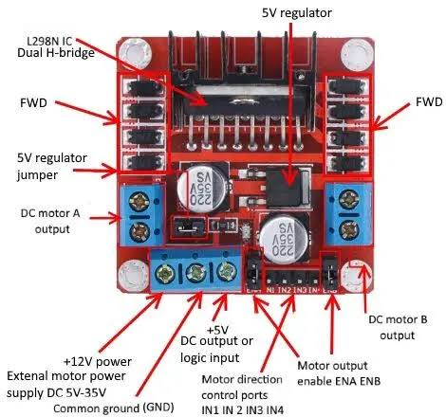
L298N Motor Driver Module:
A motor driver module is a simple circuit used for controlling a DC motor. It is commonly used in autonomous robots and RC cars (L2938N and L293D are the most regularly utilized motor driver chips)
..
The L298N is a dual H-Bridge motor driver which allows speed and direction control of two DC motors at the same time. The module can drive DC motors that have voltages between 5 and 35V, with a peak current up to 2A.
A motor driver module takes the low voltage input from a controller like Arduino. This input logic controls the direction of DC motors connected to the driver. To put it in simple words, you can control the direction of DC motors by giving appropriate logic to the motor driver module
. The motor driver module consists of a motor driver IC, which is the heart of the module. The IC alone can control the DC motor but using the module makes the interfacing with Arduino easy.

Slide 11
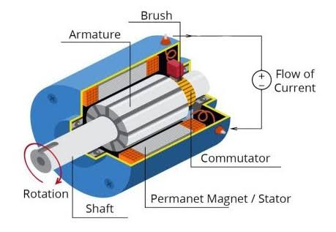
DC Motor
A DC motor is any of a class of rotary electrical motors that converts direct current (DC) electrical energy into mechanical energy
When precise control is needed, DC motors offer a wide range of possibilities concerning speed control. Due to this reason, industrial machinery that requires high precision works with DC motors
.DC motors offer excellent response characteristics when starting, stopping and reversing their spin direction
.The energy stored in the batteries of electric vehicles is in the form of DC. Hence, DC motors are compatible with electric vehicles.

Slide 12
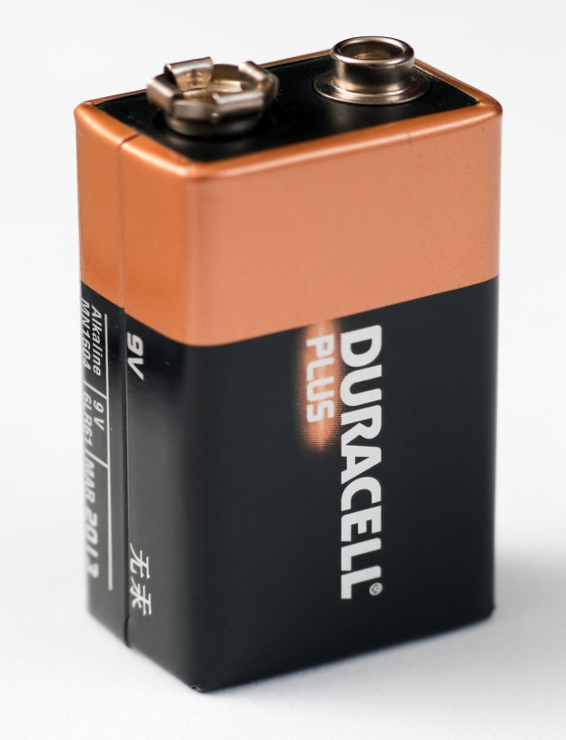
Battery
The nine-volt battery, or 9-volt battery, is an electric battery that supplies a nominal voltage of 9 volts. Actual voltage measures 7.2 to 9.6 volts, depending on battery chemistry. Batteries of various sizes and capacities are manufactured; a very common size is known as PP3, introduced for early transistor radios.
9-volt, E, or PP3 battery is a very popular 9V rectangular battery often used in portable radios, cameras, walkie-talkies, smoke alarms, alarm clocks, and other applications that require slightly larger voltage from a single battery.
9V batteries can be both non-rechargeable or rechargeable batteries, featuring different chemistries.

Slide 13
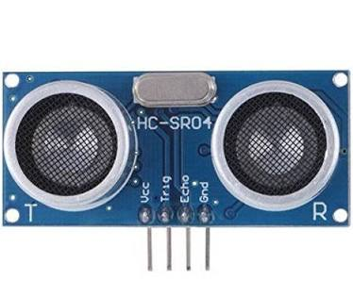
Ultrasonic Sensor
Ultrasonic sensors use sound to determine the distance between the sensor and the closest object in its path.
Ultrasonic sensors are essentially sound sensors, but they operate at a frequency above human hearing.
The sensor sends out a sound wave at a specific frequency. It then listens for that specific sound wave to bounce off of an object and come back . The sensor keeps track of the time between sending the sound wave and the sound wave returning.

Slide 14
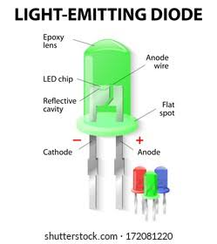
LED
LED, in full light-emitting diode, in electronics, a semiconductor device that emits infrared or visible light when charged with an electric current.
Visible LEDs are used in manyelectronic devices as indicator lamps, in automobiles as rear-window and brake lights, and on billboards and signs as alphanumeric displays or even full-colour posters.
Infrared LEDs are employed in autofocus cameras and television remote controls and also as light sources in fibre optic telecommunication systems
LEDs operate by electroluminescence, a phenomenon in which the emission of photons is caused by electronic excitation of a material.
The material used most often in LEDs is gallium arsenide, though there are many variations on this basic compound, such as aluminum gallium arsenide or aluminum gallium indium phosphide.

Slide 15
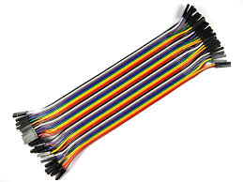
Jumper Wire
A jump wire (also known as jumper, jumper wire, DuPont wire) is an electrical wire, or group of them in a cable, with a connector or pin at each end.
It is normally used to interconnect the components of a breadboard or other prototype or test circuit, internally or with other equipment or components, without soldering. Individual jump wires are fitted by inserting their "end connectors" into the slots provided in a breadboard, the header connector of a circuit board, or a piece of test equipment. Jumper wires are simply wires that have connector pins at each end, allowing them to be used to connect two points to each other without soldering.
Jumper wires are typically used with breadboards and other prototyping tools in order to make it easy to change a circuit as needed

Slide 16

Methodology
Algorithm for operating the Android Controlled Robot car are as Follows:
Start.
Initialise Controller(Android).
Transmitte and Receive the Signal to the Microcontroller using the Wi-Fi module.
And microcontroller also getting the signal from the ultra-sonic sensor as the obstacle is detected or not.
After that this information is forwarded to the Android phone through the WiFi-module.
And then user can control the robotic car with the help of given information.
Repeating this 2 to 6 steps again again.
Finish.

Slide 17
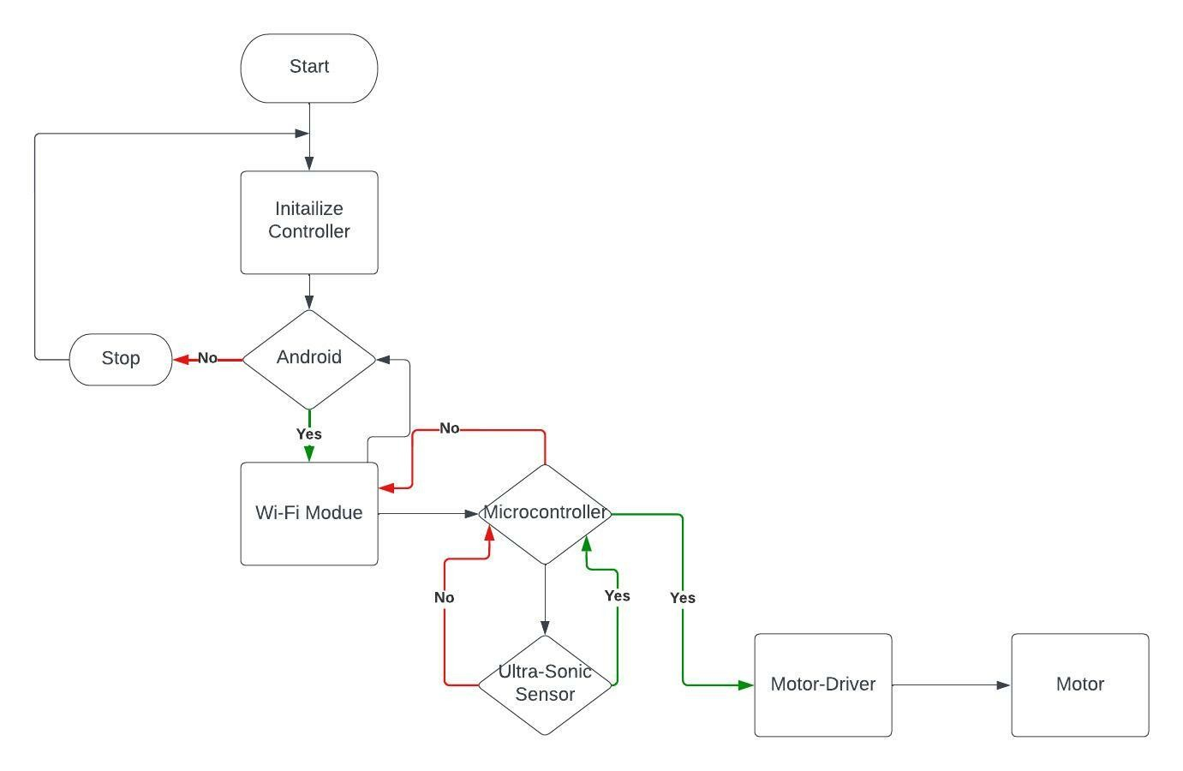
https://lucid.app/lucidchart/737330a6-c9dd-47fe-af25-d79ac9a6583e/edit?invitationId=inv_161a3a7a-6caa-4334-a68f-d71a65e95dc4&page=0_0#

Slide 18
Working
Node mcu-esp8366 Wi-Fi module main function is connect the mobile phone with custom bot via hotspot. The program needs to be downloaded from a web server, in the run. That means, you must have an online connection to the Internet.
The Nodemcu esp32 as inbuilt wi-fi module and the devices connected with robot car Both wi-fi is connected with an authentication token.
Android application will transmit command using wi-fi to the car so that it can move in the required direction like moving forward, reverse, turning left, turning right and stop.
For development purpose that is welcome, but for normal operation it is cumbersome.

Slide 19

Application
•
It provides for more development of applications based on android operating system. Such as,
Application based on sensors (accelerometer, gyroscope) etc. With tremendous smart phone in markets, it is bound to have many more applications in near future.
•
•
It is robust, sensitive and fast moving, hence can be applied in rescue operations. Android control car can use for Army transportations also in the red alert areas.

Slide 20
Discussion on Result
•
After completing this project user are able to control his car using the android phone.
•
Also user can avoid the accident because user kwon the distance between the car and the obstacle in front of the car.
•
When the obstacle is in front of the car the car is automatically stop that’s way the probability of accident is decreases.

Slide 21

Conclusion
After completing this project we will conclude the following conclusion:
To us the need of internet and the things which are internet based are very much important nowadays. IOT or internet of things is the very important part in both computer and our daily lives. The above model describes how the ardunio programs the car motor module and by IoT we actually rotate the wheels and give direction to the car. IoT gives us the opportunity to work with different platforms and it helps us to create various interesting modules to work on. We also tested the applications used to drive the car. Due to the new concept of Wireless Controlled Car using Bluetooth, Wifi and IOT, we were able to come up with various possibilities that can take place

Slide 22

Budget of Project
In this project we are using the following components:-
Componensts | Price
Arduino | 750
Wi-Fi Module | 220
ESP 8266(1) | 350
Relay Driver(2) | 250
DC Motor | 50
Motor Driver | 250
UltraSonic Sensor | 135
Servo Motor(2) | 250
Chassis | 500
Wheels | 200
Other Components | 150
Total Cost | 3105

Slide 23


References
Hebah H O Nasereddin and Abdelkarim A A (2010). Smartphone control robots through bluetooth, Source: IJRRAS, Vol. 4.
Parmar D, Tripathi D, Sahni A, Singh P (2015). Bluetooth operated robot vehicle using mobile android
app. Int. J of Res. in Eng. & Adv Technol, Vol. 3, Issue 2,
Eshita R Z, Barua T, Barua A and Dip A (2016). Bluetooth based android controlled robot. American Journal of Engineering Research (AJER). Vol. 5, Issue 3, 195-199.
Schaffer A A, Haddadin S, Ott Ch, Stemmer A, Wimbock T and Hirzinger G (2007). The DLR
lightweight robot: design and control concepts for robots in human environments. Industrial Robot: An International Journal,Vol.34, No. 5, 376–385.
Gandotra S, Sharma B, Mahajan S, Motup T, Choudhary T and Thakur 45-48.
P (2016).Bluetooth controlled RC car using Arduino. Imp. J of Interdisciplinary Research (IJIR) Vol. 2, Issue. 9, 144-147.
Ashima, Kumar R, Nikhil T, Singh P (2015). Obstacle avoidance and Anderoid mobile phone
controlledBluetooth robot using arduino. IJEEE, Vol. 2, 9-11

Slide 24
Dickmanns E (2002). The development of machine vision for road vehicles in the last decade. Proc. IEEE Intelligent Vehicle Symp., Vol. 1, IEEE Press, 268–281.
Kato S (2002). Vehicle control algorithms for cooperative driving with automated vehicles and intervehicle communications. IEEE Trans. Intelligent Transportation Systems, Vol. 3, No. 3, 155–161.
Android Apps Controlled ROBO Car by Microcontroller using Bluetooth BENJIR AHMED1 , M. AHASAN HABIB2 , SABUJ KHAN1 , SHANTONU KAISHER1 , RUMA1 1.Deptartment of EEE, Dhaka University of Engineering & Technology (DUET), Gazipur, Bangladesh 2Dept of IPE, National Institute of Textile Engineering and Research (NITER), Bangladesh.
Robots: Brave New World moves a step closer Archived 14 January 2019 at the Wayback Machine, By James Melik, reporter, Business Daily, BBC World Service, 3 January 2013.

Slide 25
Acknowledgement
We would like to express our spacial thanks to our project guide Miss.R.N.Deoker(Assistant Professor AVCOE, Sangamner) for their valuable and important guidance and support in the project.
We all are also like to extend my gratitude to the our project coordinator Dr.S.R.Jondhale and HOD of E&TC Dr.R.P.Labade for providing me help for the project with all the facility which is required to the project.
Mr. Pranav Ambre (Roll No:04 )
Mr. Shubham Bhadake(Roll No: 08) Mr. Abhishek Gade (Roll No:16) Miss.Smita Mandlik(Roll No:42)

Slide 26

Thank You !
•
Amrutvahini College of Engineering, Sangamner
•
Mrs.R.N.Deoker (Project Guide), AVCOE, Sangamner
•
Internal Project Evaluation Committee (IPEC)

